Slide 1
Online Shop Performance
Business Performance & Customer Insights
January 2024 – June 2026
Prepared by Nontokozo Mthimunye

Slide 2
Executive Summary
Three findings define the shop's current performance.
≈ 1.62M
Electronics revenue
≈ 879.92K
Tehran revenue
≈ 1.2M
Revenue at 0% discount
• Electronics generate the vast majority of revenue, far ahead of all other categories.
• Tehran is the strongest geographic market and contributes more than twice Mashhad's revenue.
• Revenue falls as discount percentage increases, indicating that heavier discounting is eroding financial returns.
• Regular customers are the largest revenue segment, while the VIP segment represents an opportunity for growth.
Online Shop Performance | Nontokozo Mthimunye | 2

Slide 3
Category Performance
Electronics are the clear commercial engine of the shop.
Electronics
1.62M
Accessories
517.51K
Home Office
416.55K
Wearables
404.54K
Gaming
184.49K
Stationery
61.84K
• The customer base primarily treats the shop as a technology destination rather than a general-goods store.
• Protect availability and margins in Electronics while using weaker categories selectively for inventory-clearing promotions.
Online Shop Performance | Nontokozo Mthimunye | 3

Slide 4
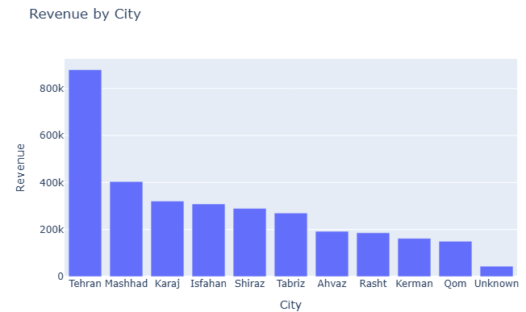
Geographic Performance
≈ 879.92K
Tehran revenue
≈ 404.02K
Mashhad revenue
• Tehran is the central revenue engine and generates more than twice the revenue of Mashhad.
Online Shop Performance | Nontokozo Mthimunye | 4

Slide 5
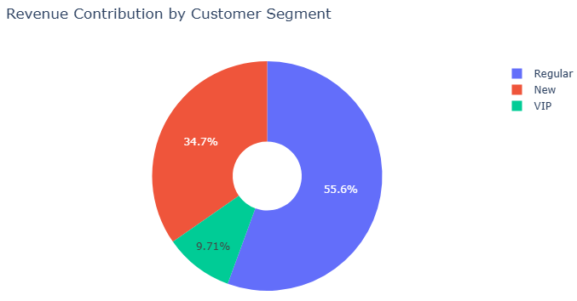
Customer Segment Performance
55.6%
Regular-customer share
• Regular customers contribute 55.6% of total revenue, making them the financial backbone of the business.
• New customers contribute 34.7%, indicating healthy acquisition.
• VIP customers contribute only 9.71%, highlighting an opportunity to convert high-frequency Regular customers into higher-value relationships.

Slide 6
Discount Impact
Higher discount levels are associated with substantially lower total revenue.
• Revenue is highest at 0% discount and generally declines as discount percentage increases.
• discounts are not compensating for the reduction in selling price through higher transaction value.
• The 25% discount bucket records no revenue in the analysis.
≈ 1.20M
718.73K
627.73K
354.96K
203.18K
100.61K
0K
0%
5%
10%
15%
20%
25%
30%
Online Shop Performance | Nontokozo Mthimunye | 5

Slide 7
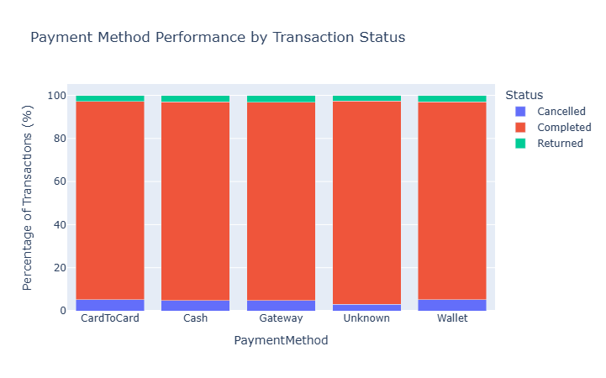
Payment Reliability
Payment method
Completed
Returned
Cancelled
Card to Card
92.12%
2.80%
5.20%
Cash
92.12%
3.04%
4.84%
Gateway
91.90%
3.22%
4.86%
Wallet
91.89%
3.02%
5.08%
Unknown
94.22%
2.67%
3.11%
• Completion rates remain above 91.8% across payment methods, indicating payment friction is not a current bottleneck.
Online Shop Performance | Nontokozo Mthimunye | 6

Slide 8
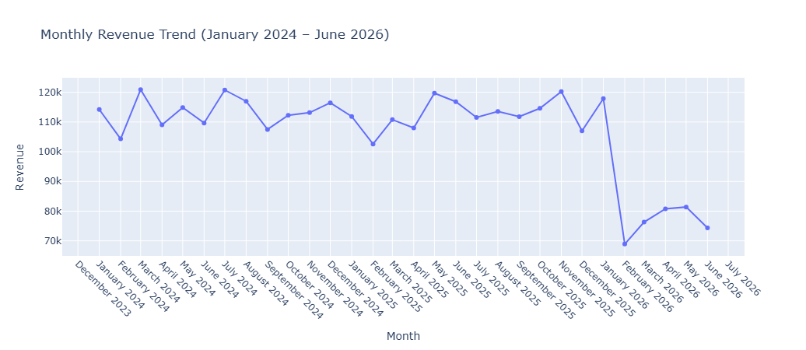
Revenue Seasonality
Despite consistent revenue between 110k and 120k through 2024 and 2025, revenue experienced a sharp drop in January 2026

Slide 9
Strategic Recommendations
1
Restructure the Discount Strategy
Scale back broad discounting initiatives across high-demand product lines.
Restrict promotional price reductions exclusively to clearing slow-moving inventory, such as Gaming and Stationery, rather than discounting high-demand Electronics.
2
Localize High-Value Marketing
Spend more money on ads and put our best products in Tehran, because that is where we the most sales occur
3
Build a VIP Conversion Pipeline
Give special rewards to our best shoppers so they spend more money and keep coming back.
Online Shop Performance | Nontokozo Mthimunye | 7

Slide 10
Key Takeaway
Protect the Electronics-led revenue base, focus growth efforts in Tehran, reduce unnecessary discounting, and convert strong Regular-customer performance into a larger VIP customer base.
Thank you

